Slide 1

AI
Teoh Teik Toe
ITOM/NBS
ttteoh@ntu.edu.sg
97905202

Slide 2
Agenda
Intro to AI
AI Models
https://tssglobalsingapore-my.sharepoint.com/:f:/g/personal/teohteiktoe_tssglobalsingapore_onmicrosoft_com/EuIUbA0qyvFOugKwzm5IKesB_qwPBHox0n9mnlGqaRZ_xg?e=TSJM80

Slide 3
Other important knowledge
Cloud
Big Data
Full Stack (Front Back End)
UI/UX
Automation

Slide 4
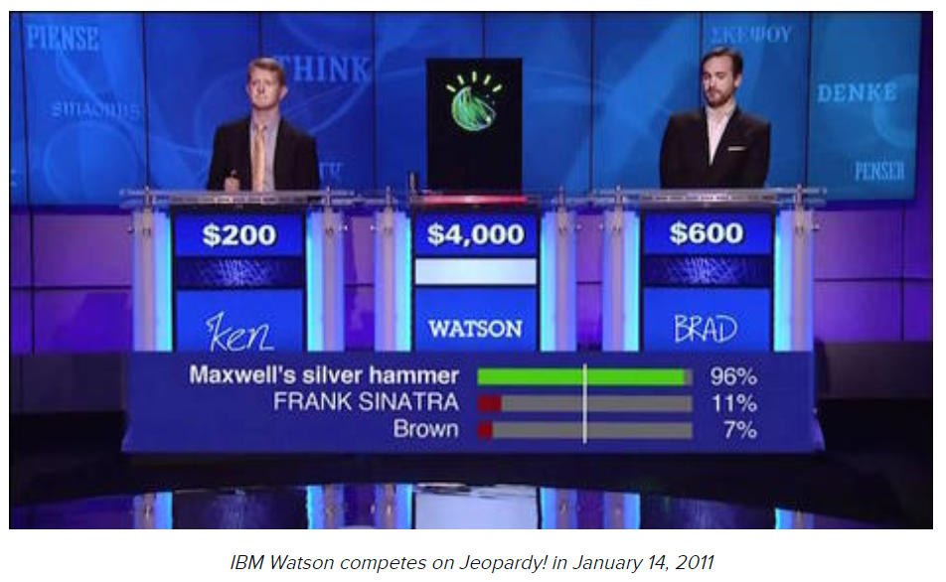
What is AI
Back in the 1950s, the fathers of the field, Minsky and McCarthy, described artificial intelligence as any task performed by a machine that would have previously been considered to require human intelligence.
https://www.zdnet.com/article/what-is-ai-everything-you-need-to-know-about-artificial-intelligence/

Slide 5
Reading : Textbook
Main
TT Teoh AI in Business & Finance Springer 2021
Artificial Intelligence in Finance. HilPisch. O’Reilly. 2019.
Python for Data Analysis, 2e: Data Wrangling with Pandas, Numpy, and Ipython. Wes Mckinney. O’Reilly. 3 November 2017
Secondary
Artificial Intelligence in Finance: A Python-Based Guide (1st Edition). Yves Hilpisch. O’Really. 2020.
Mathematics for Machine Learning. Marc Peter Deisenroth. Publisher : Cambridge University Press. 2020.
Machine Learning in Finance: From Theory to Practice by Dixon, Matthew F
PattePattern Classification, 2nd Edition Richard O. Duda, Peter E. Hart, David G. Stork. Publication : Wiley.
Hands-on Machine Learning with Scikit-Learn, Keras, and TensorFlow: Concepts, Tools, and Techniques to Build Intelligent Systems, 15 October 2019 by Aurelien Geron (Author)

Slide 6
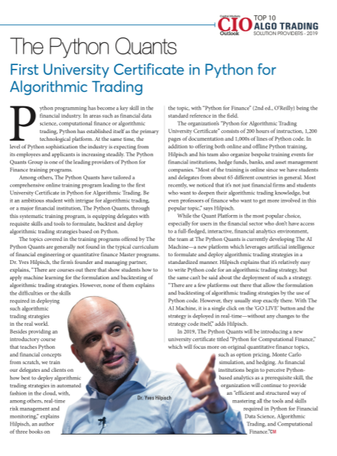
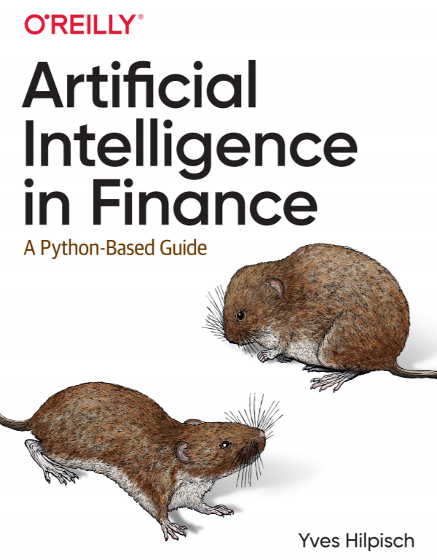
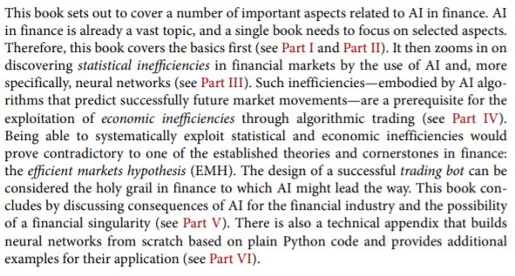

Hilpisch, 2019

Slide 7
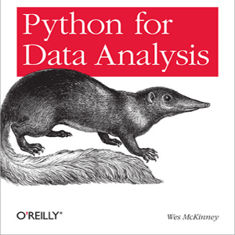

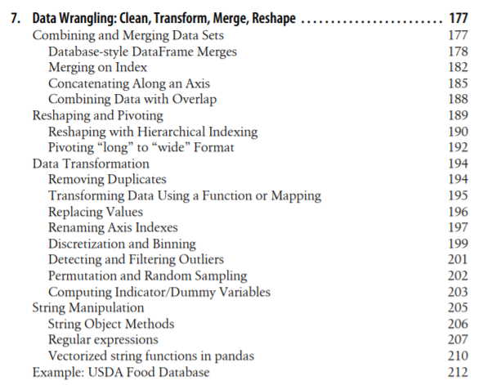
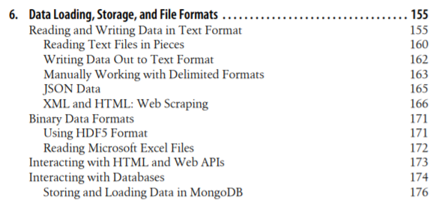
Mckinney, 2017

Slide 8
Youtube
https://youtu.be/2ePf9rue1Ao
https://youtu.be/ukzFI9rgwfU
https://youtu.be/ujTCoH21GlA
https://youtu.be/RnFGwxJwx-0
https://youtu.be/2BusGJyn77E

Slide 9
Components of AI
Analytics
Prediction
Automation

Slide 10
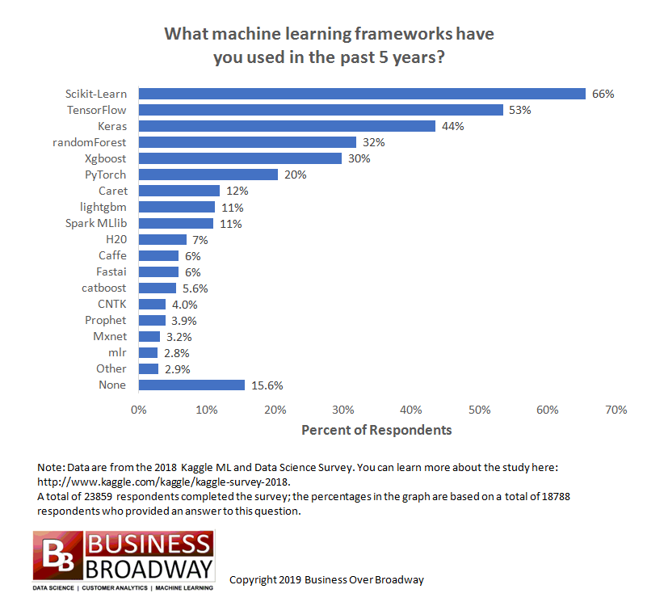

Slide 11
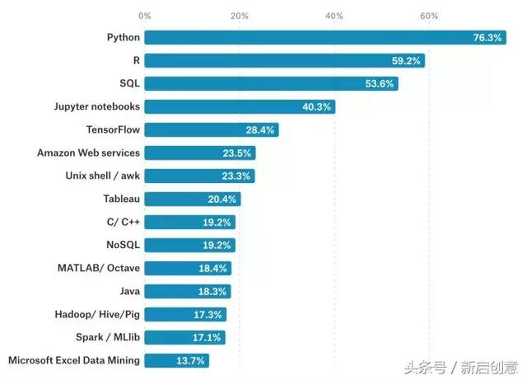
Programming Language for AI

Slide 12
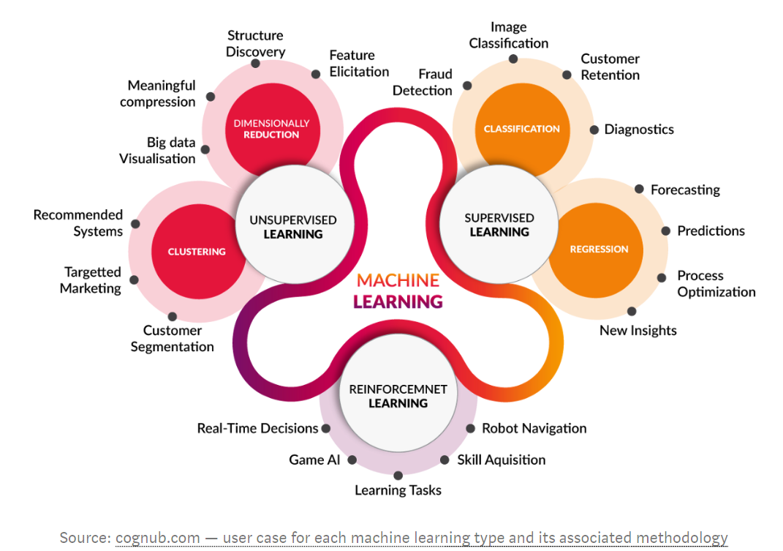

Slide 13
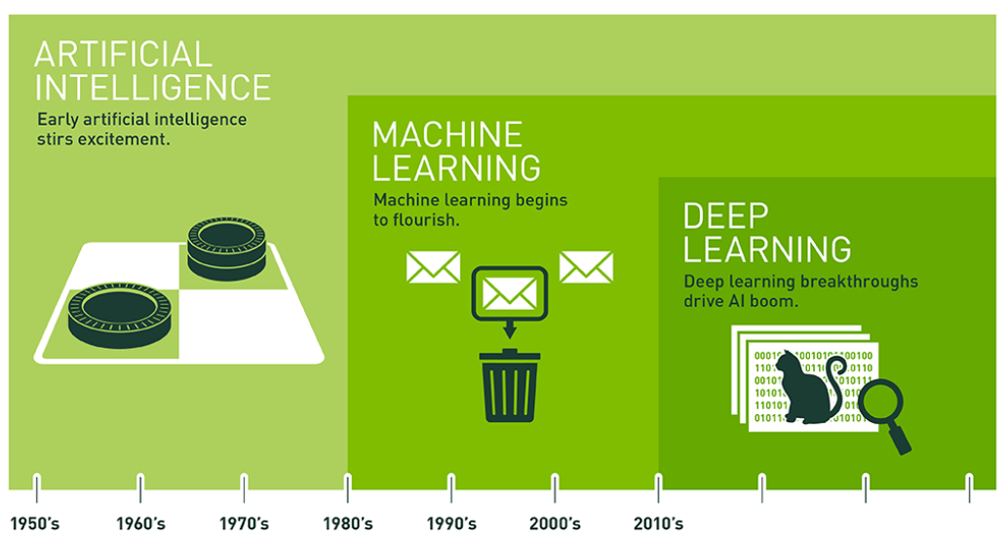
https://blogs.nvidia.com/blog/2016/07/29/whats-difference-artificial-intelligence-machine-learning-deep-learning-ai/

Slide 14
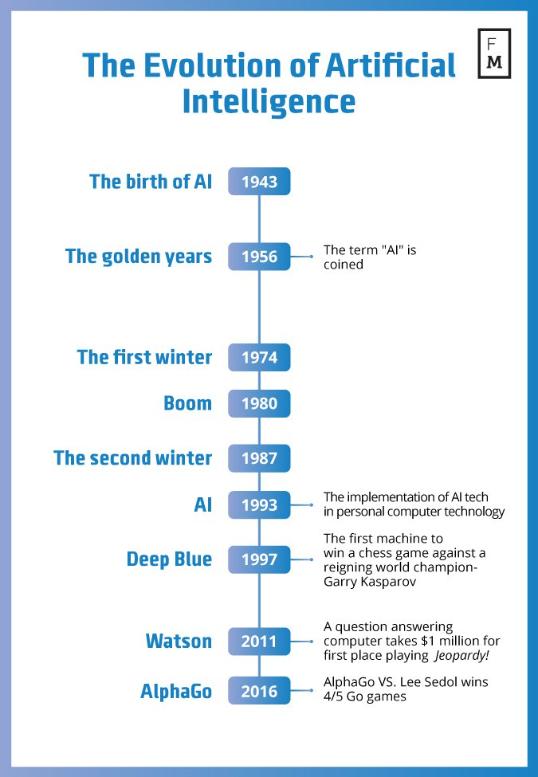
Evolution in AI
Source: https://davidlecea.wordpress.com/2016/11/10/robots-on-the-rise-how-ai-can-change-the-financial-world/

Slide 15
AI and Big Data
AI and Big Data
Internet of Thing
Robotic Process Engineering
Block Chain
AI & Big Data
Cloud
Natural Language Processing

Slide 16

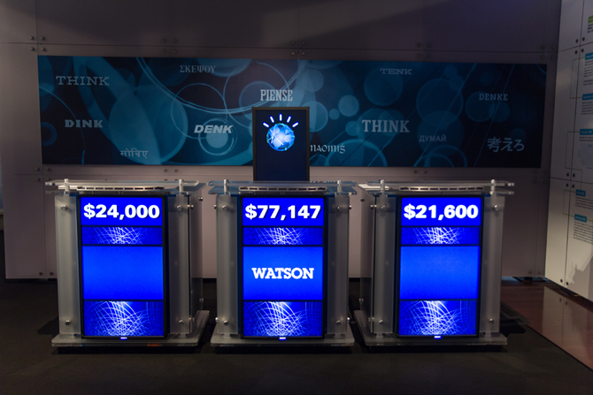
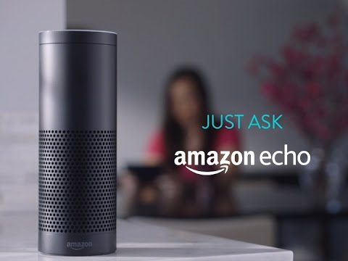
AI
AI : Machine to imitate intelligent human behavior
Popular AI Machine : IBM Watson, Apple Siri, Amazon Echo, Alpha Zero, Xiao Du
Source: https://sanvada.com/2018/01/27/ibm-believes-artificial-intelligence-will-change-world/
Source: https://tecake.in/amazon-echo-will-now-read-twitter-trends-alexa-assistant-updated

Slide 17
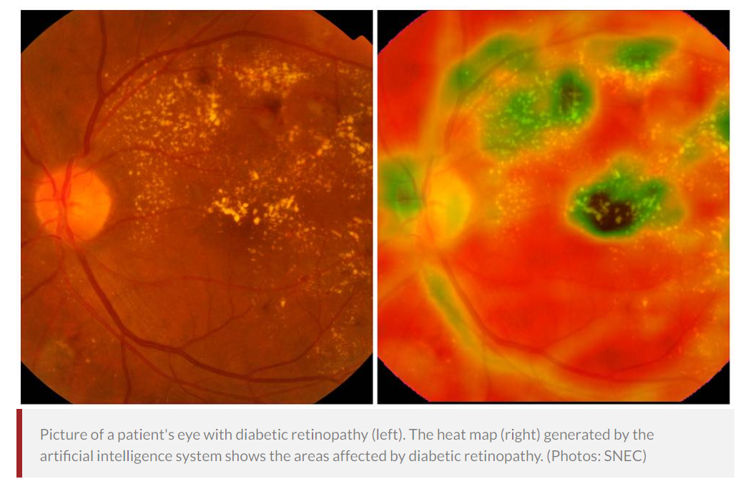
Singapore AI: Detect Eye Conditions
In a world first, Singapore-developed artificial intelligence system detects 3 major eye conditions
Singapore National Eye Centre (SNEC), Singapore Eye Research Institute (SERI) and National University of Singapore (NUS) School of Computing.
Deep Learning System (DLS)
5 million images next 5 years
30 co-investigators
500,000 retinal images
180,000 out of 600,000 Singaporeans with diabetes have diabetic retinopathy – lead to blindness.
https://www.channelnewsasia.com/news/singapore/in-a-world-first-singapore-developed-artificial-intelligence-9498742

Slide 18
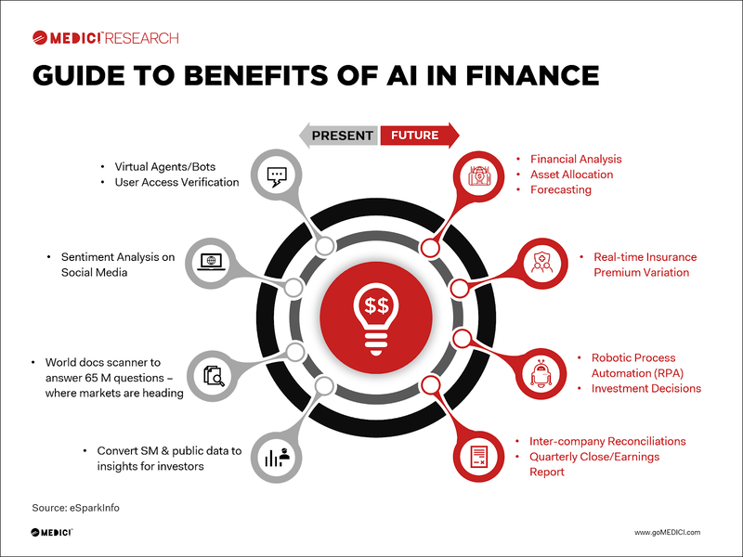

Slide 19
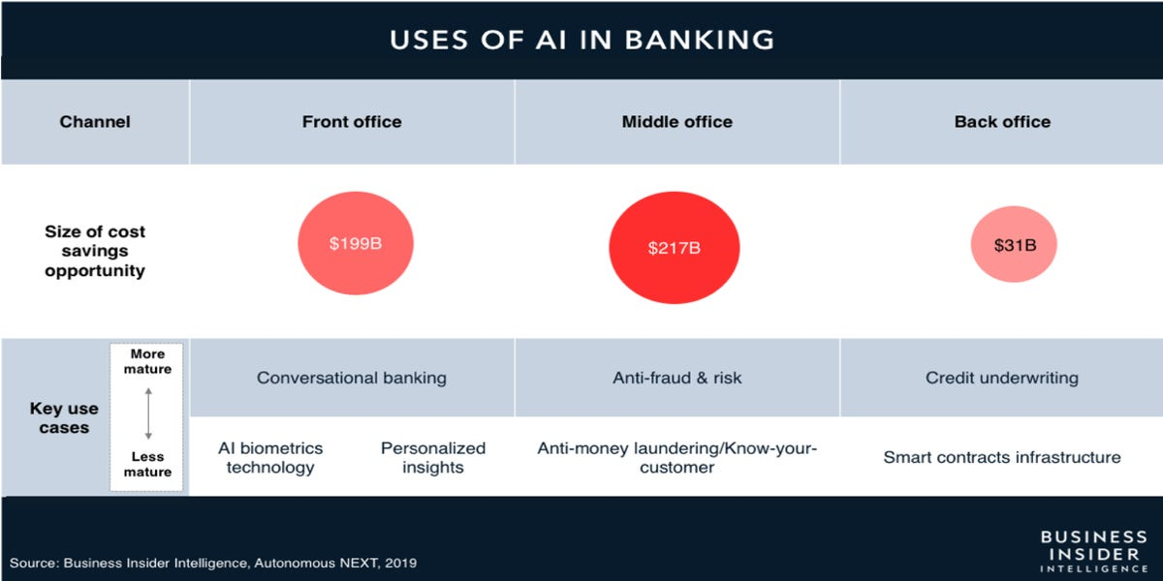

Slide 20
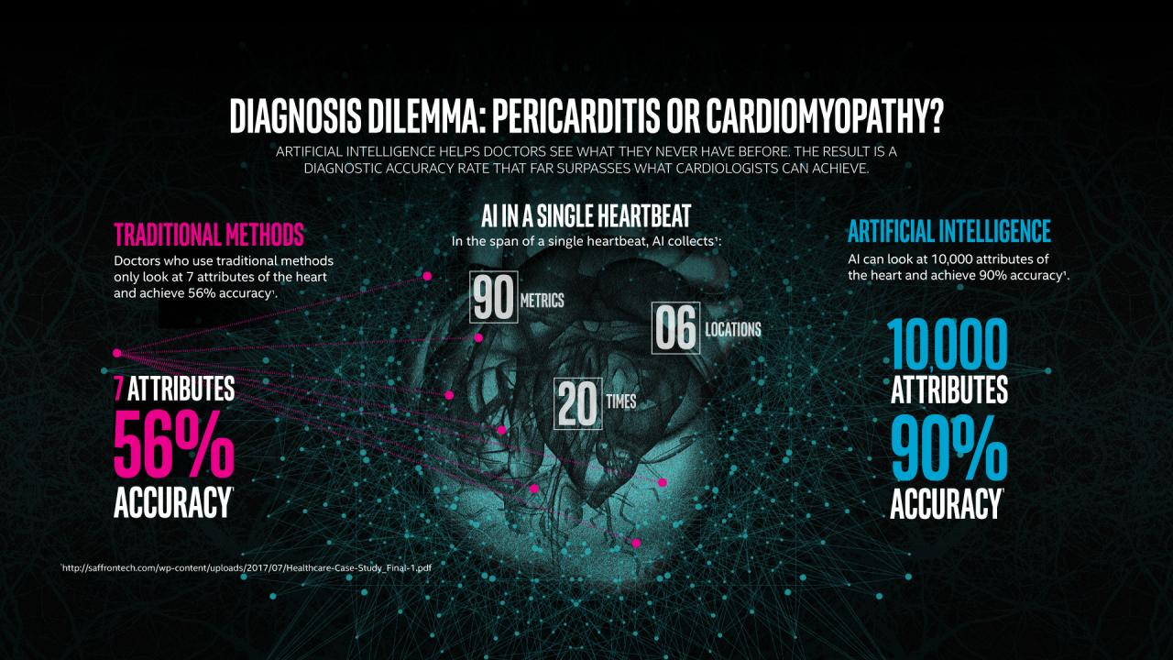
Cardiologist vs AI
Source: https://www.intel.com/content/www/us/en/healthcare-it/article/improved-diagnosis.html

Slide 21
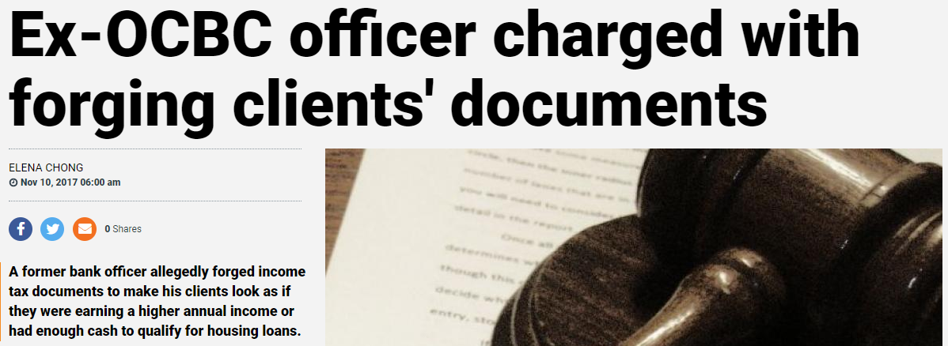
Data for banks: Security
Fraud Detection
Providing security is critical for both employees and customers.
With the scale of number of transactions, banks need to use Machine Learning as a proactive approach to security.
The key steps to fraud detection could include:
Data samplings for model estimation and preliminary testing
Model estimation
Testing
Source: https://www.tnp.sg/news/singapore/ex-ocbc-officer-charged-forging-clients-documents

Slide 22

Data for banks: Planning
Risk Modeling
Better cash/liquidity planning
How do you price your financial instruments? Through big data, banks can evaluate multiple streams of data sets and with a team of data scientists, develop risk modelling to employ a data-driven approach to pricing and risks.
You can track past usage patterns, daily coordination between in-and-out payments at branches and ATMs.
Predictive Analytics can be used to predict future needs of potential customers – leading to optimal management of the liquid assets.

Slide 23
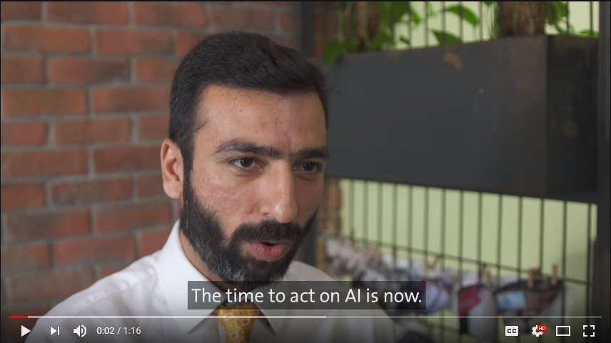
AI in Banking: Singapore
OCBC Bank launches its own artificial intelligence (AI) unit
Source: https://www.youtube.com/watch?v=eA78W8-dRlY

Slide 24
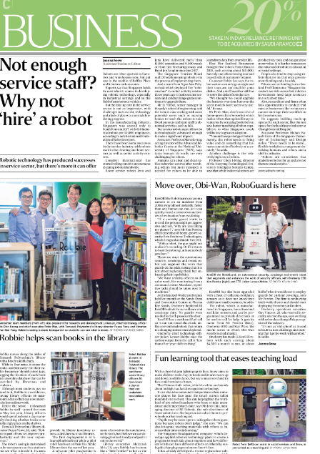
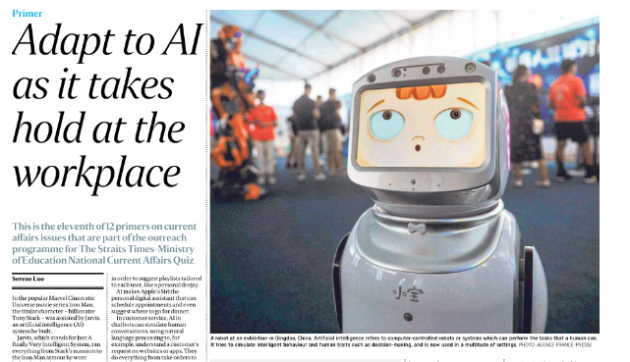
Why not hire a robot? Straits Times - 13 Aug 2019 Teachers Librarian Security Guard

Slide 25
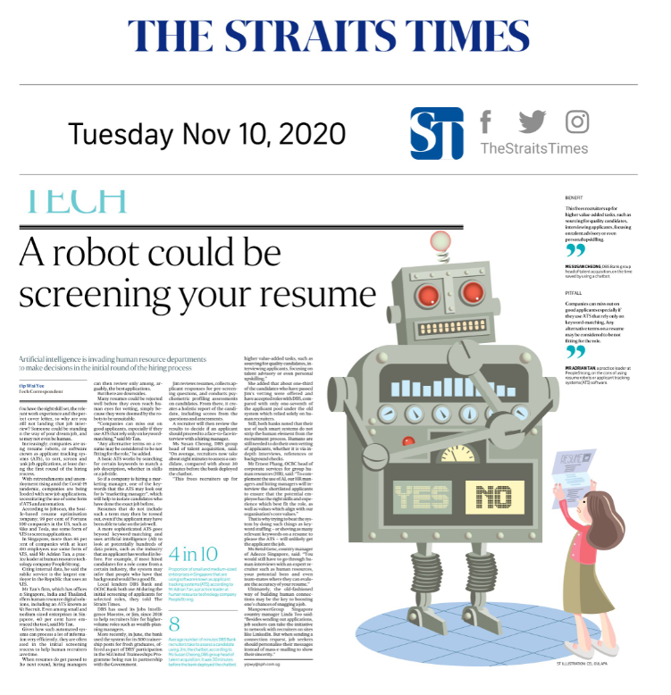

Slide 26
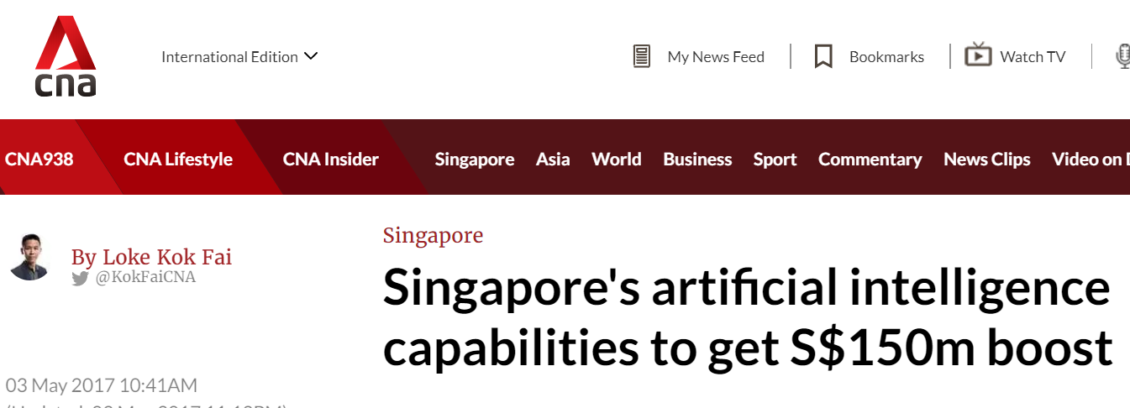
National Research Foundation (PMO): S$150million in AISG (May 2017)
https://www.nrf.gov.sg/programmes/artificial-intelligence-r-d-programme

Slide 27
Brains and Computers
Brain
200 billion neurons, 32 trillion synapses
Processing speed: 100 Hz
Parallel
Inputs are approximately summed
Computer
1 billion bytes RAM but trillions of bytes on disk
Processing speed: 10⁹ Hz
Serial
Activation Function : Sum

Slide 28
Deep Learning, Big Data, Distributed Computation
Deep Learning (LSTM by TensorFlow)
Big Data (Hadoop)
Large Distributed Computation (Spark)

Slide 29
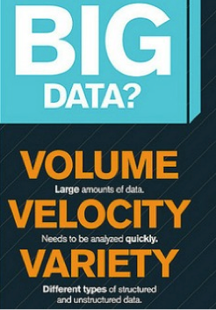

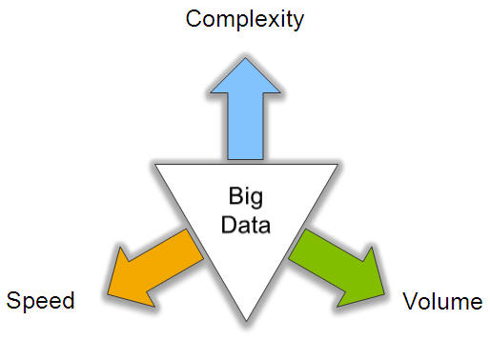
Big Data: 3V’s

Slide 30
AI Models

Slide 31
Top 10 Machine Learning Algorithms Every Engineer must know
Naive Bayes Classifier Algorithm
K Means Clustering Algorithm
Support Vector Machine Algorithm
Apriori Algorithm
Linear Regression
Logistic Regression
Decision Tree
Random Forest
Artificial Neural Networks
Nearest Neighbours
https://www.dezyre.com/article/top-10-machine-learning-algorithms/202

Slide 32
AI Model and Popular Application
Classifier (Supervised) – Machine Learning
Regression (Financial or Economic Prediction)
Decision Tree (Operation Research)
Random Forest (Operation Research)
XG-Boost (Operation Research)
SVM (Text, Handwriting and Biology Classification)
Naïve Bayesian (Document classification, Word Frequency)
Genetic Algorithm (Solar Collector, Antenna Location)
Multi-Layer Perceptron (General Classification)

Slide 33
AI Model – Deep Learning Model and Popular Application
Hidden Markov (Speech and Handwriting Recognition)
Recurrent Neural Network (Speech and Handwriting plus Time Series Analysis)
Long Short Term Memory (Same as RNN)
Generative Adversarial Network (Fashion, Art, Game)
Convolution Neural Network (Picture Recognition)

Slide 34
AI Model
Clustering (Unsupervised)
K-Means (Market Segmentation) – KNN classifier
Gaussian Mixture Model (Market Segmentation)
Others
Reinforcement Learning (Robot, Autonomous Vehicle)
Auto-Encoder (Reduce dimension for Picture)
Kernel Density Estimator (Advance Data Wrangling technique to reduce outlier and noise)
Manifold Learning (Feature Selection for large Dimension)
Block Chain (Transaction base application like trading of share)
Robotic Process Automation (Automation)
Chatbot (Automation)

Slide 35
AI Model – Feature Selection
Kernel Density Estimator
Manifold Learning (Similar to PCA)
Correlation Coefficient
Random Forest

Slide 36
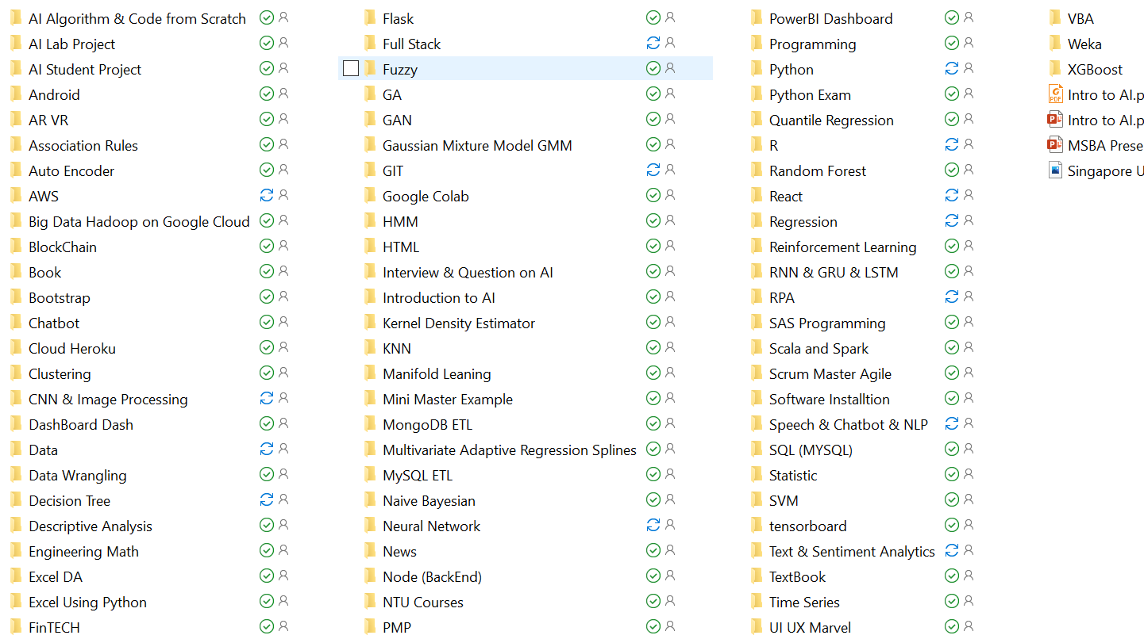
Library

Slide 37
Python
Basic Python – Variable, control flow, function
Data Structure – Array, list, dictionary, stack, queue
OOP – Class, subclass, instance, object, constructor, methods, private, static, abstract
SQL – CRUD
Network – Socket, REST API, json & json-server, XML, request, configuration file
Others – Decorator, Generator, Lamba, Exception, PIP, PYC, PyPI, Namespace, Virtual Environment, Multiple Variable, configuration, Multi-threading, Pipe, file, Magic, tktinker, Pickle & Shelve
Excel Using Python

Slide 38
Software Needed
Google Colab
Anaconda
R & R Studio
R Studio Cloud
Weka https://www.cs.waikato.ac.nz/ml/weka/downloading.html
UiPath

Slide 39

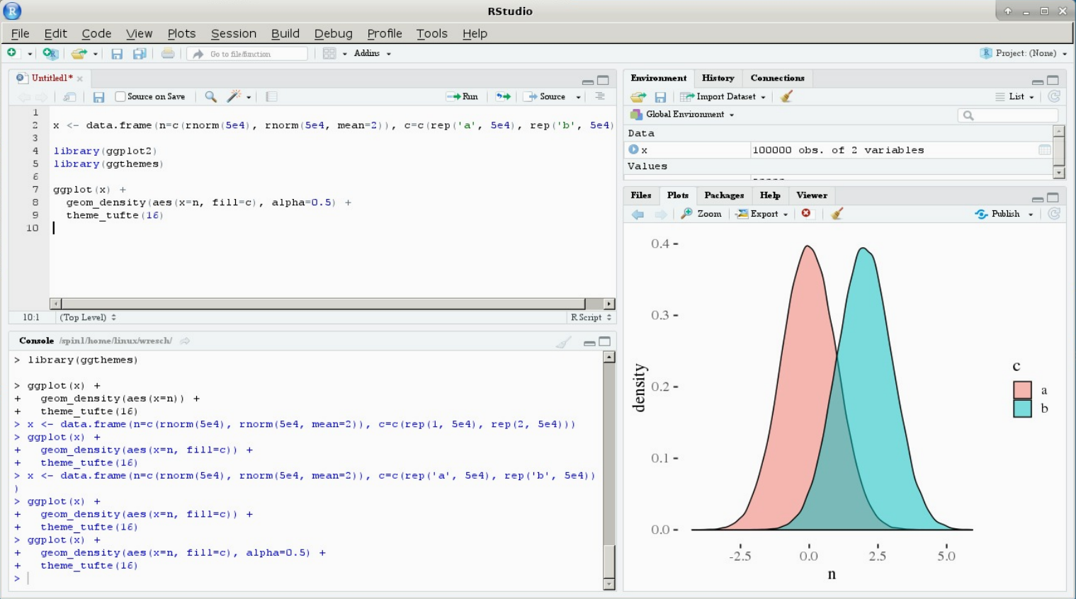
Software
R (R Foundation)
RStudio (RStudio Inc) is an integrated development environment (IDE) for R

Slide 40

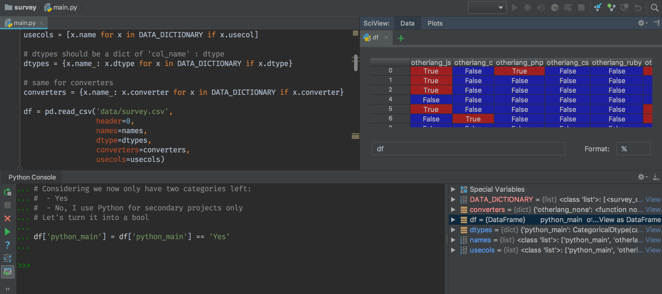
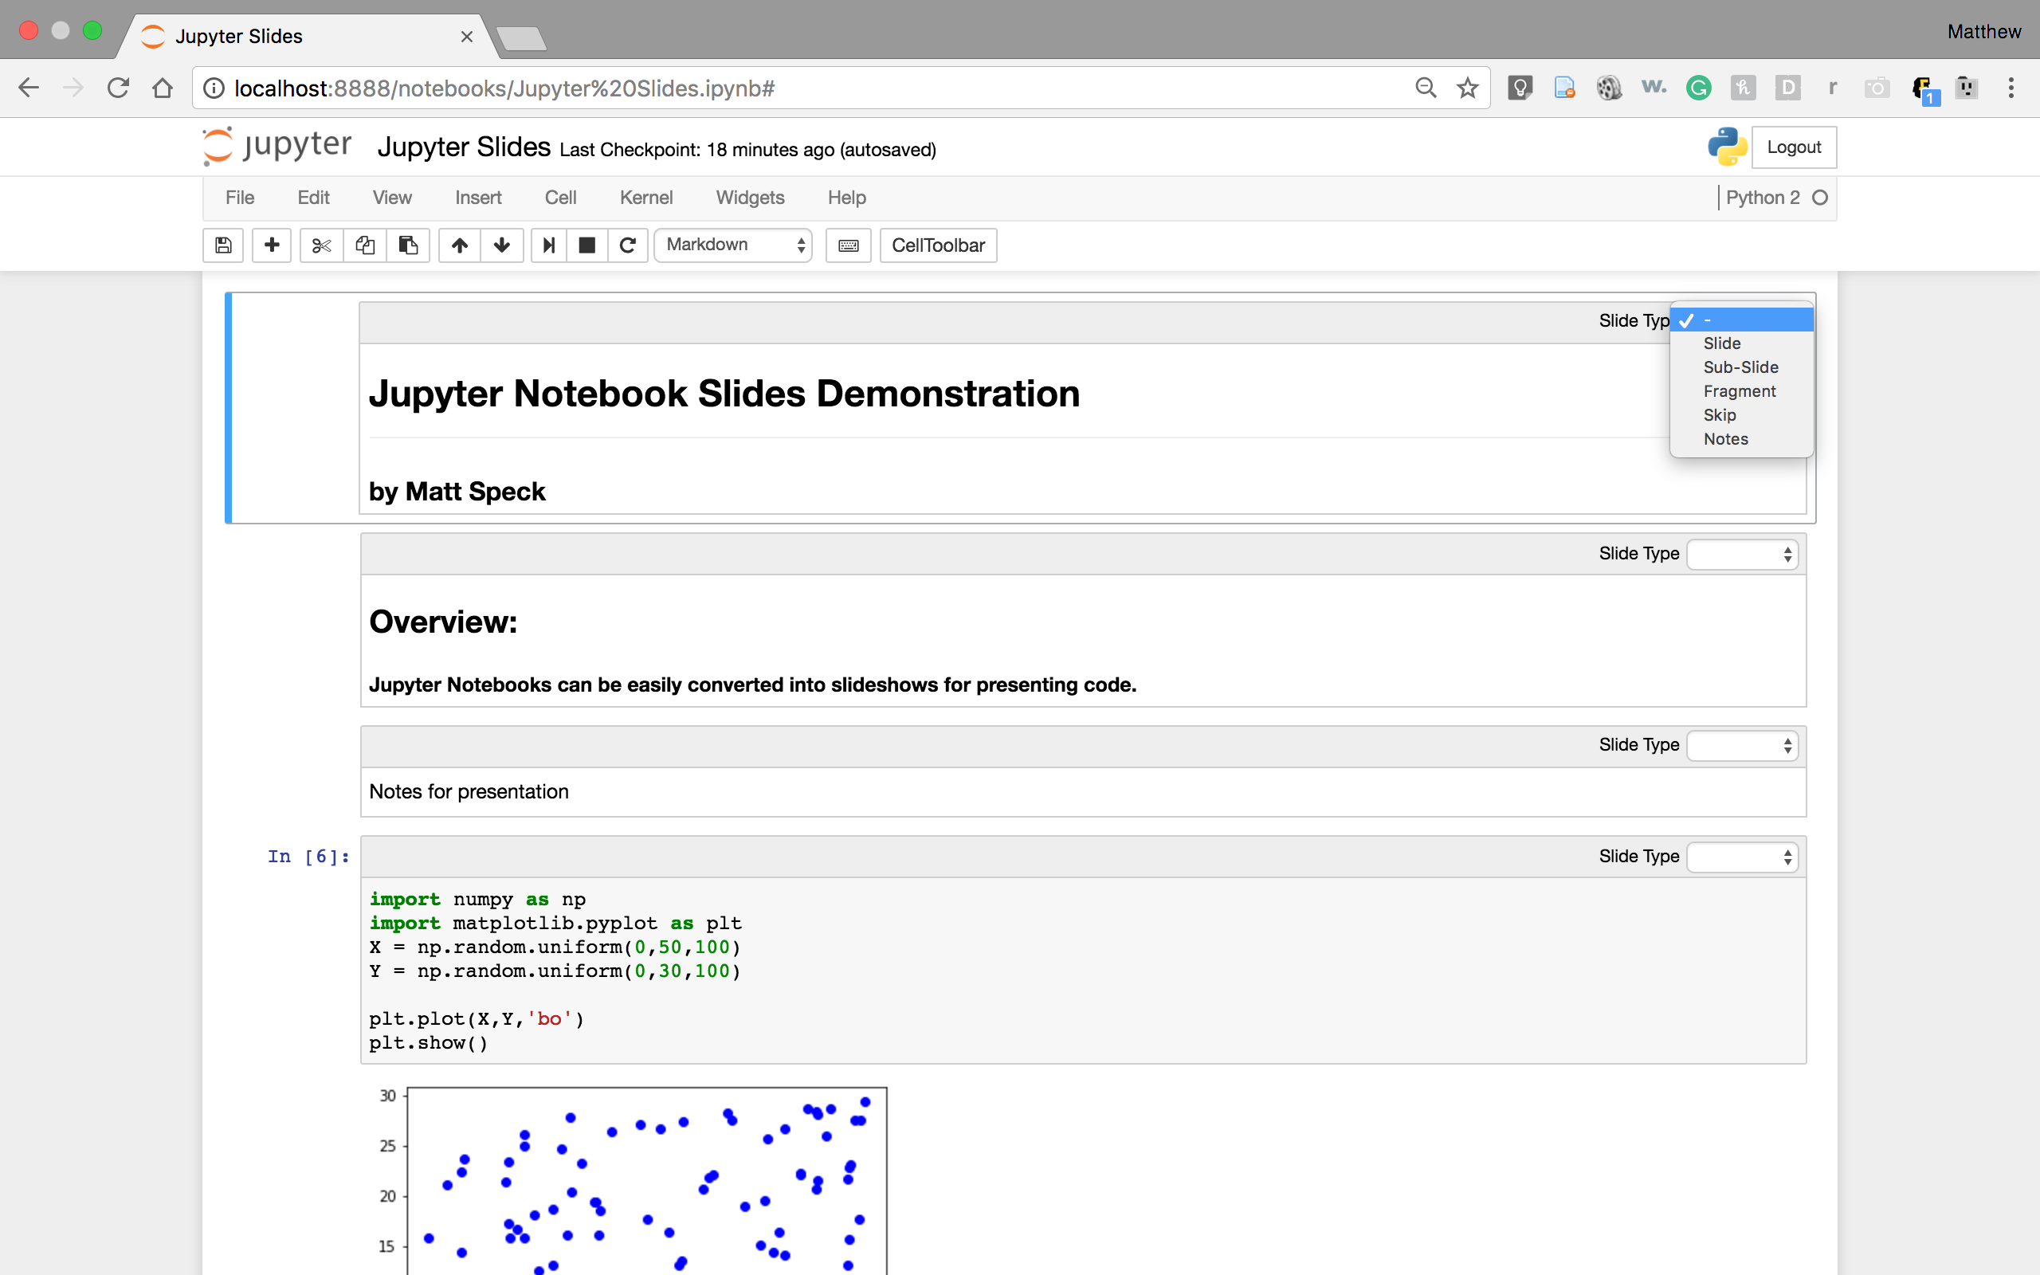
Python, PyCharm, Anaconda, Jupyter
Python (Python Foundation)
PyCharm (IDE) - JetBrains
Anaconda & Jupyter (IDE) – (Anaconda Inc) 1500 packages

Slide 41
Noncoding Tools
Weka (AI)
Waikato Environment for Knowledge Analysis (Weka), developed at the University of Waikato, New Zealand.
Data preprocessing, clustering, classification, regression, visualization, and feature selection
Excel Plugin (Data Analytics)

Slide 42
Libraries & Packages
Tensor Flow
Keras
Numpy
Scipy
Pandas
SK Learn

Slide 43
Other Consideration in AI

Slide 44
Y, Independent Variable, Label, Target
Usually on the 1st or Last Column
Can be continuous, 2 classes classification or multiple classes classification

Slide 45
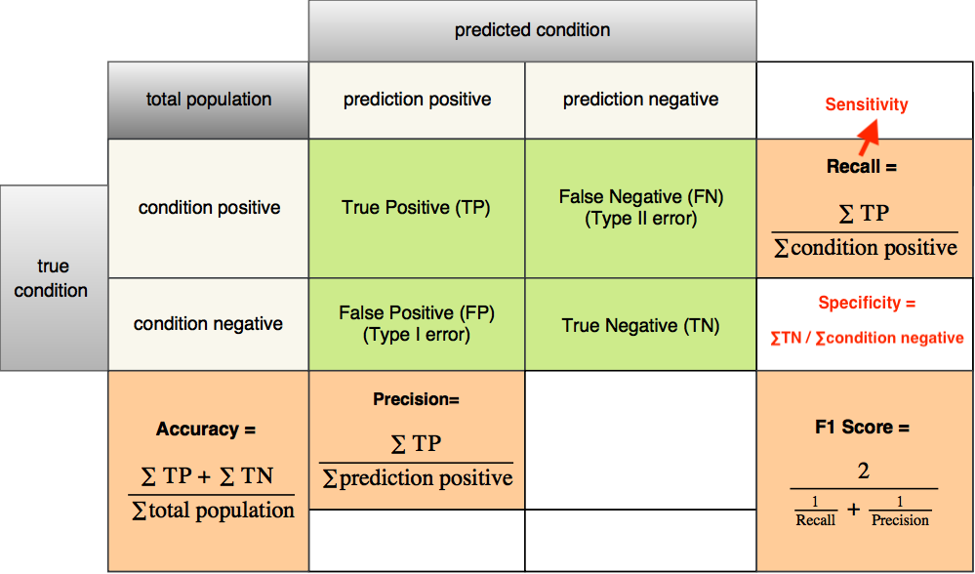
Classification Y: Accuracy
https://images.app.goo.gl/yGHjQrE27emHFTRd7

Slide 46
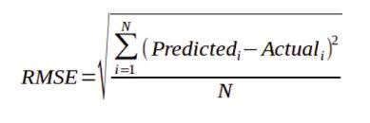
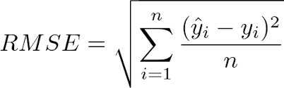
Continuous Y
MSE
RMSE

Slide 47
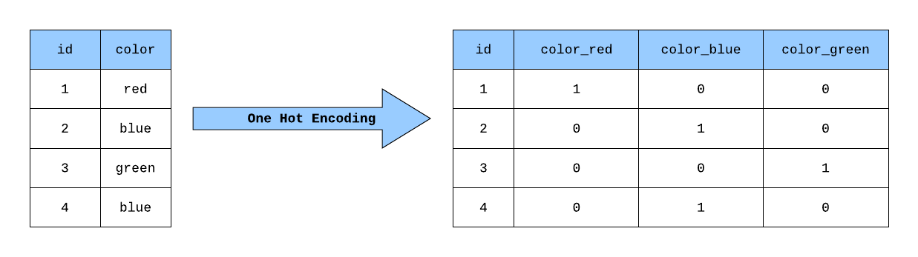
Categorical X
R – Factor or Hard Coded
Python – Dummy or One Hot Encoding or Hard Coded

Slide 48
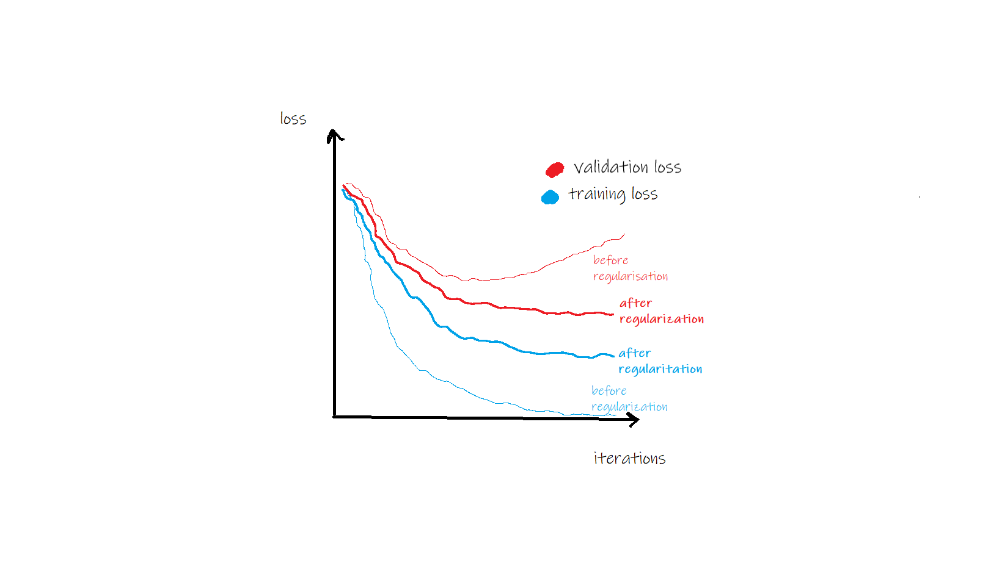
Generalization & Regularization
https://towardsdatascience.com/generalization-regularization-overfitting-bias-and-variance-in-machine-learning-aa942886b870

Slide 49
Other Regularization Method (Avoid overfitting)
Regression: Lasso, Ridge
Decision Tree: Pruning
Neural Network: Dropout

Slide 50
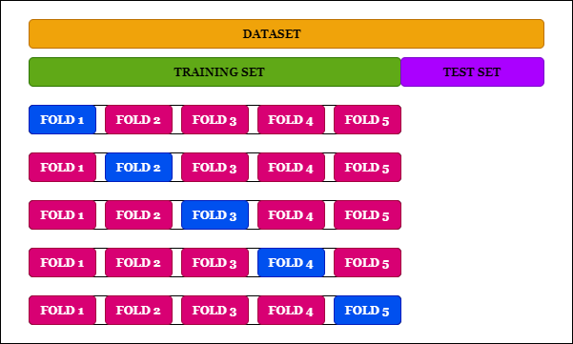
Cross Validation

Slide 51
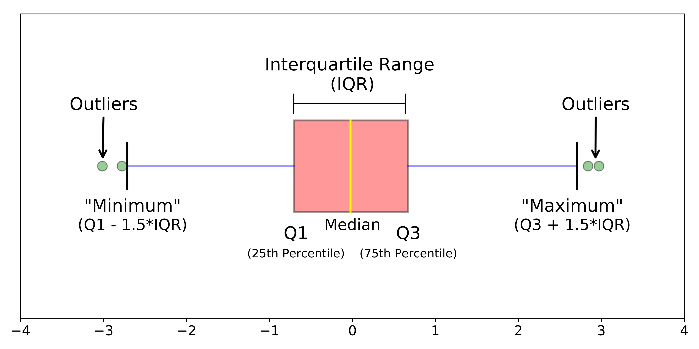
Outlier

Slide 52
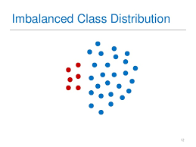
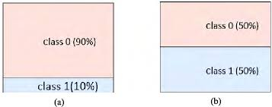
Imbalance Data Oversampling/Under-sampling

Slide 53
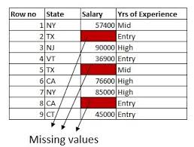
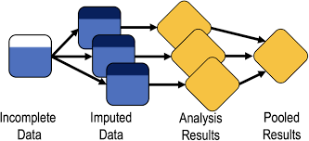
Missing Data (Non time series)

Slide 54
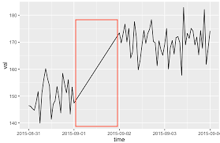
Missing Data (time series)

Slide 55
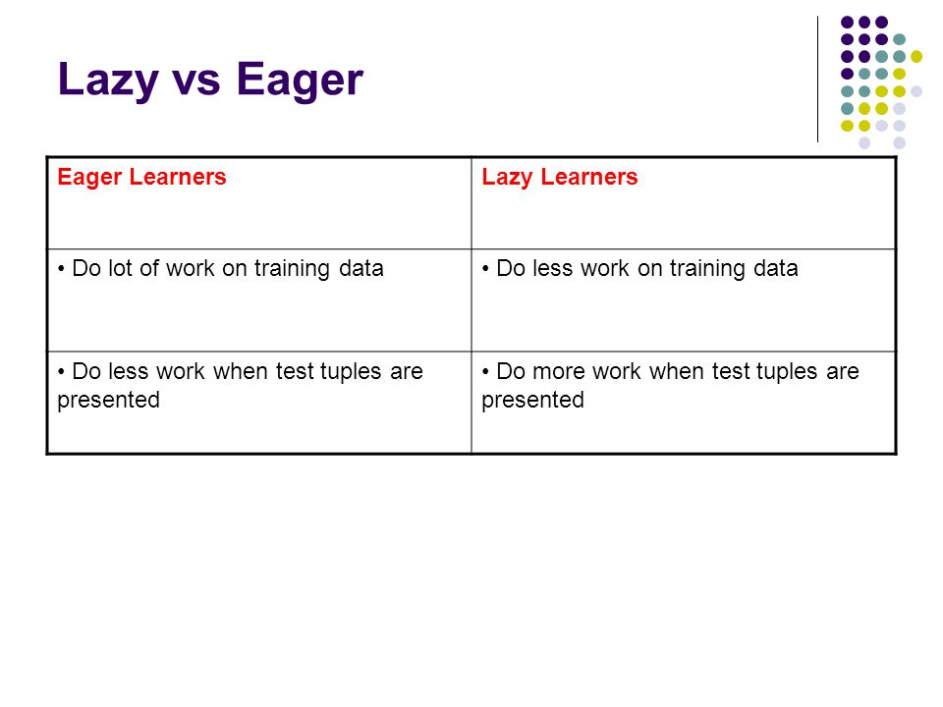
https://images.app.goo.gl/q9aHwvKF6EYhfueQ8

Slide 56
Descriptive vs Predictive (Structured Data)
Descriptive | Predictive
Statistic (Min, Medium, Mean, Max, Distribution Analysis, Standard Deviation, Confidence Interval) Hypothesis Testing Bar Plot | Regression Decision Tree Neural Network

Slide 57
Feature Selection
 | Continuous | Categorical/Classification
Regression | t-test (* in R) | OR
Decision Tree | Feature Ranking Function (variable.important) | Feature Ranking Function (variable.important)
Neural Network | GW | GW
Feature Selection Model | PCA, RELIEF | PCA, RELIEF
Statistical | Correlation (r) | Correlation (r)

Slide 58
Presentation
Web-based
Dash
PowerBi
Tableau
Excel

Slide 59
Thank You

Slide 60
Useful Link (AI)
https://www.edureka.co/blog/interview-questions/artificial-intelligence-interview-questions/
https://intellipaat.com/blog/interview-question/artificial-intelligence-interview-questions/
https://www.springboard.com/blog/artificial-intelligence-questions/

Slide 61
Useful Link (Data Science)
https://www.simplilearn.com/tutorials/data-science-tutorial/data-science-interview-questions
https://towardsdatascience.com/over-100-data-scientist-interview-questions-and-answers-c5a66186769a
https://www.edureka.co/blog/interview-questions/data-science-interview-questions/
https://www.springboard.com/blog/data-science-interview-questions/

